Slide 2
Entity Framework 2.2
Goh Chun Lin, Haulio CTO
@goh_chunlin | https://cuteprogramming.wordpress.com

Slide 3
Agenda
Project Setup
A bit of Face API =)
Ownership
Spatial Extension
WithTag()
CosmosDB Provider
EF Core Roadmap

Slide 4
Project Setup

Slide 5
Project Setup
http://bit.ly/dotnetconfsg
https://github.com/goh-chunlin/DotnetSgPhotos
It is open source!

Slide 6
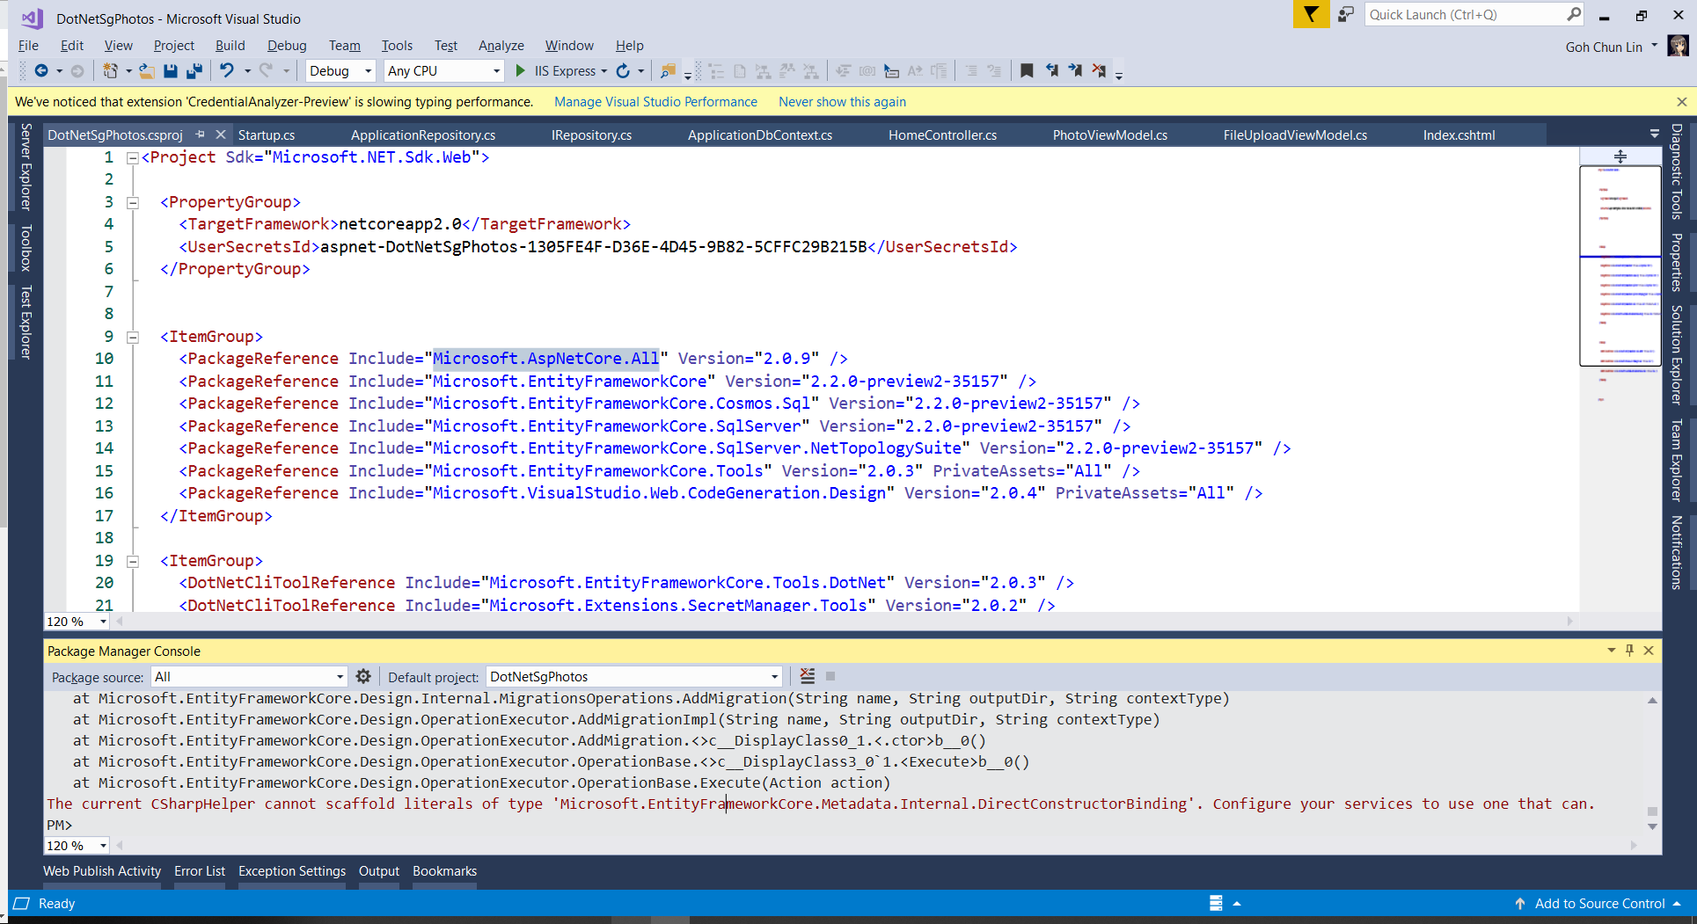
From .NET Core 2.0 to 2.2

Slide 7
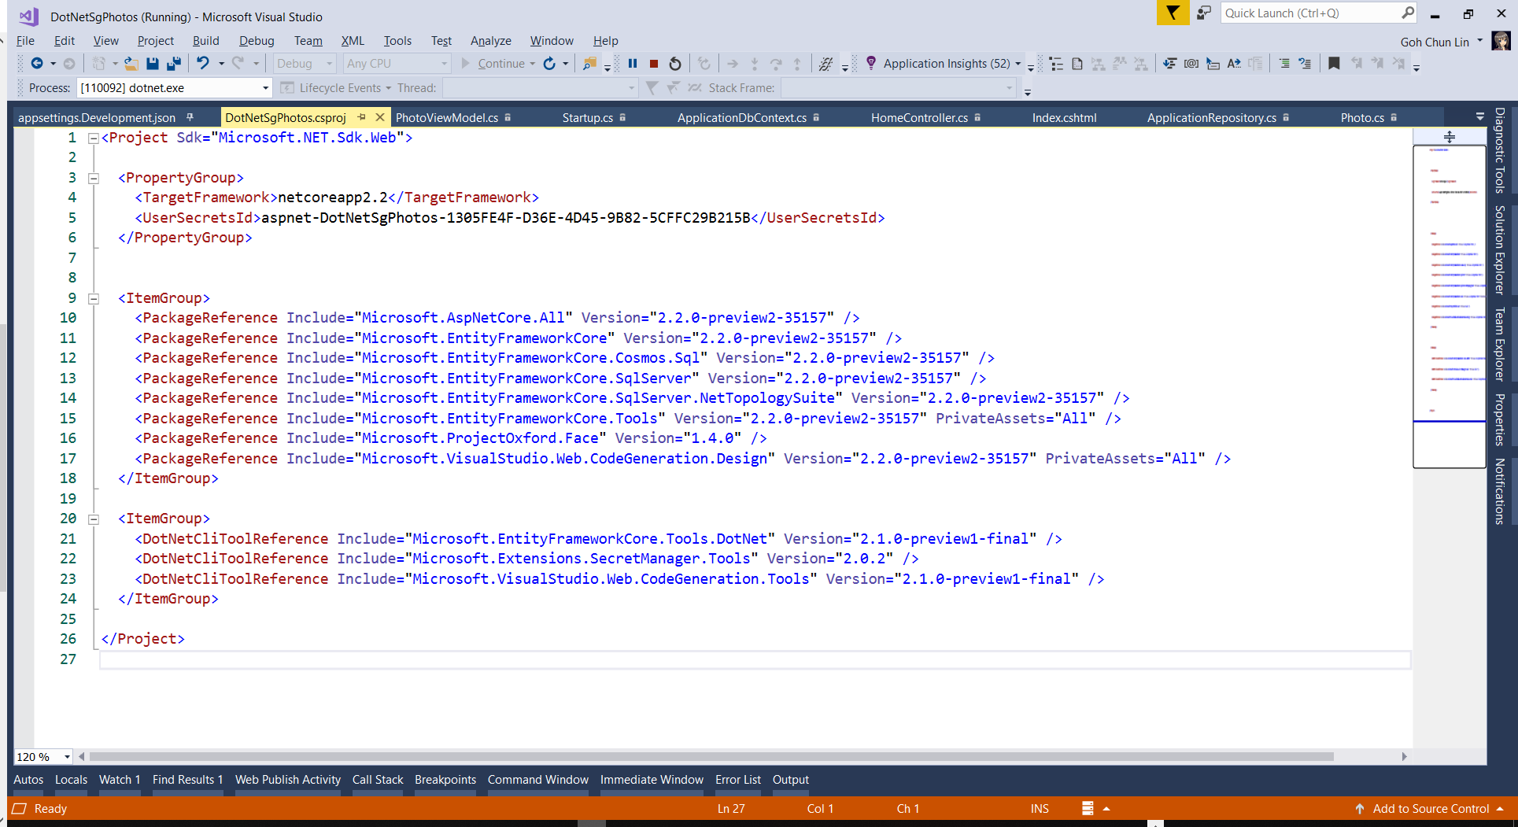
Updated csproj

Slide 8
Demo

Slide 9
New Updates

Slide 10
Ownership
Complex Type in EF6
Own types are introduced in 2.0
Need to use Fluent
Don't need to Include(). They are included automatically
There is a bug now. Need to add primary key for the owned entities
This feature is mainly for CosmosDB Provider

Slide 11
Demo

Slide 12
Spatial Extension
For geometric space (Point, Line, Polygon)
Geometric column on SQL Server
UseNetTopologySuite: Included translation in LINQ
Shipped two days ago!

Slide 13
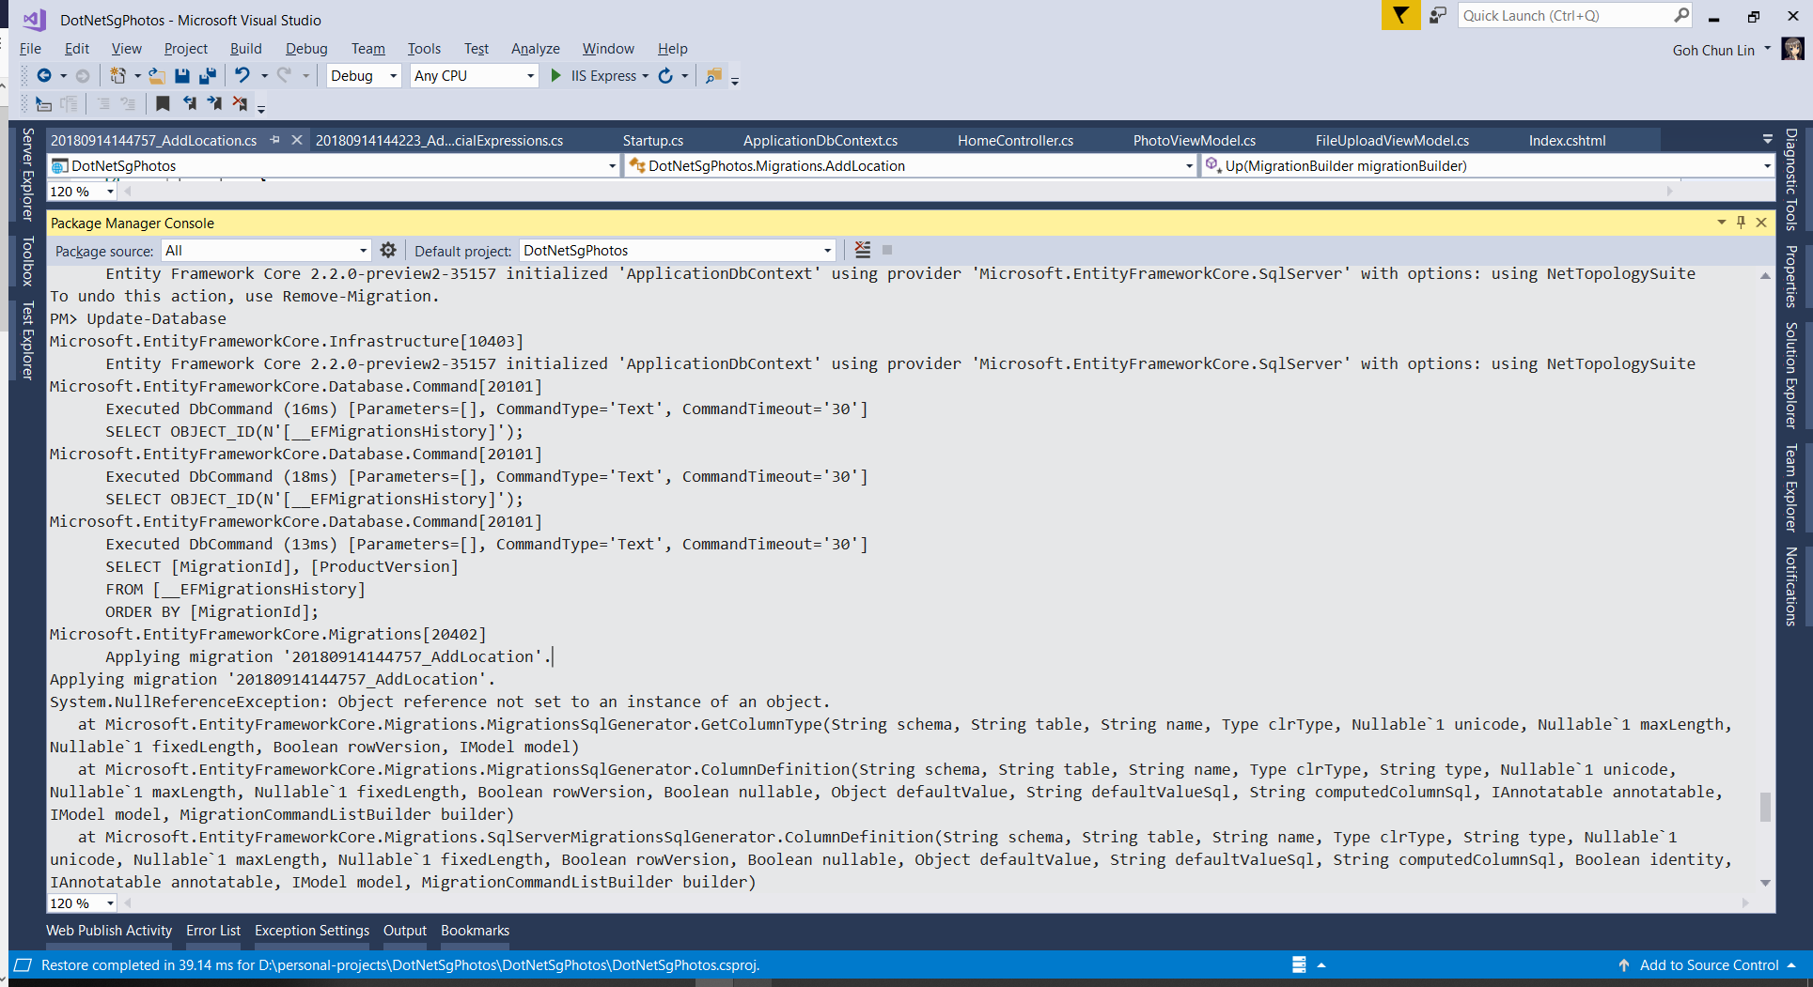
Geometry instead of Geography

Slide 14
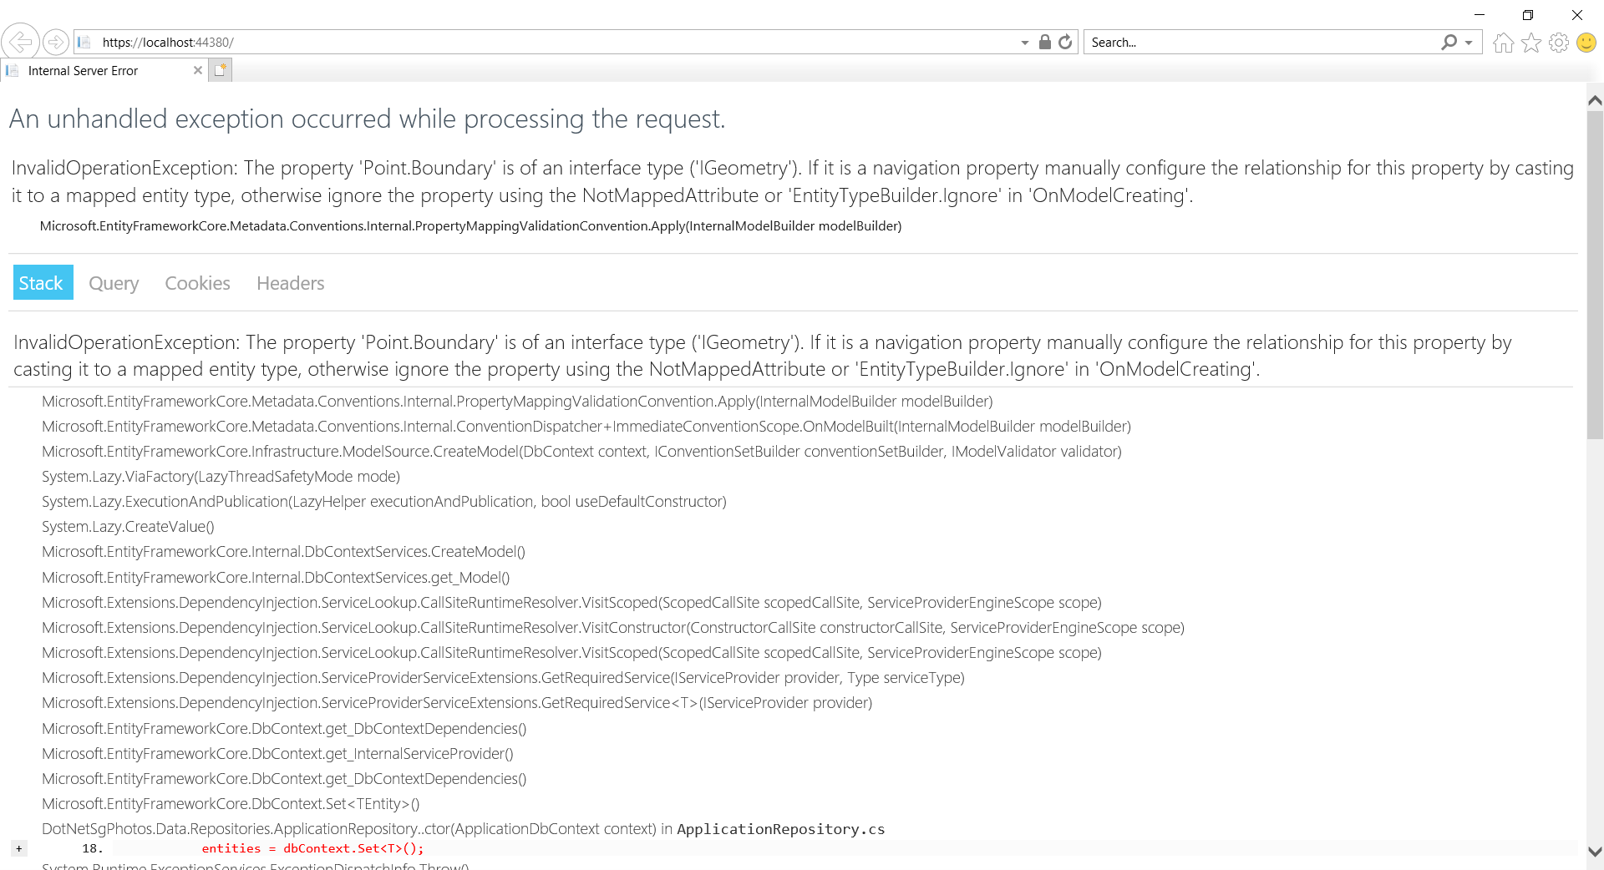
Geometry instead of Geography

Slide 15
Demo

Slide 16
WithTag()
Uniquely identify the query
Help in logging
Application Insights

Slide 17
Demo

Slide 18
CosmosDB
No longer prototype
Uniformity between SQL and NoSQL
UseCosmosSql()
Store many into one collection or many collection
Discriminator
MongoDB is not applicable

Slide 19
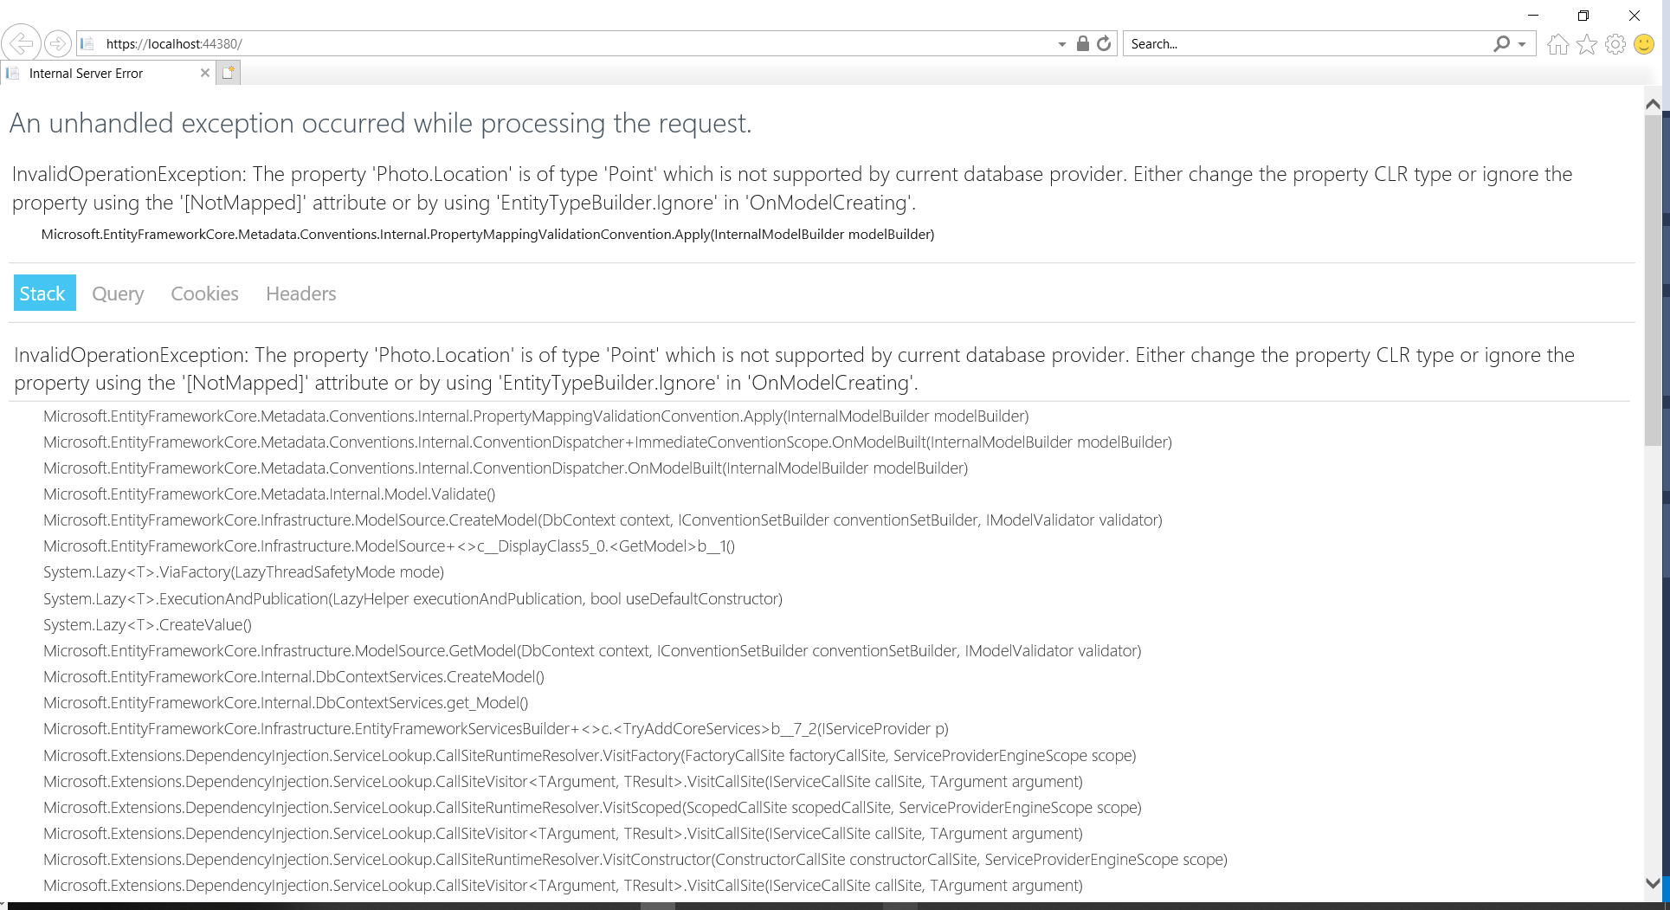
Point not Supported

Slide 20
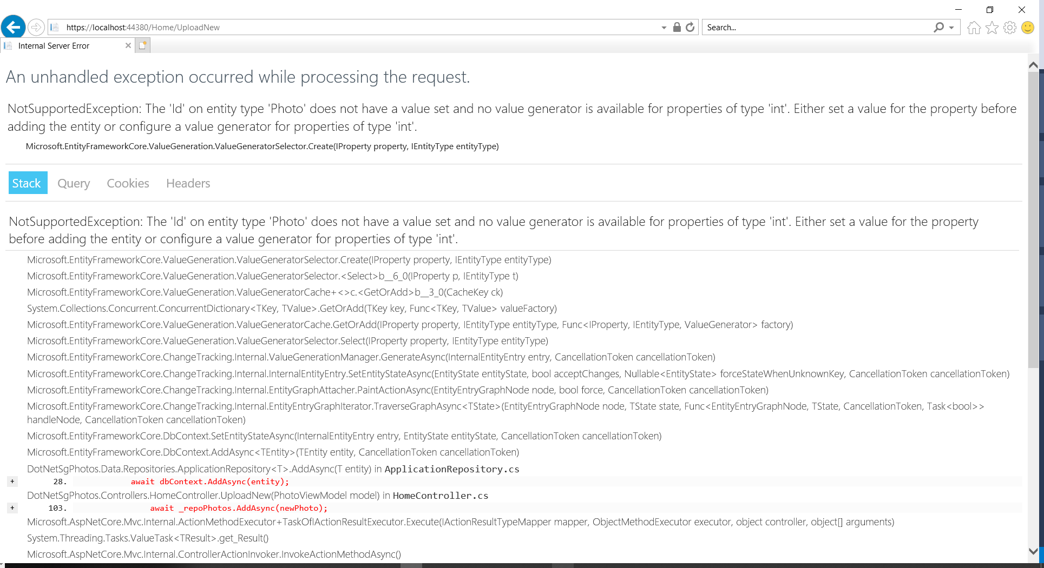
Problem of Id

Slide 21
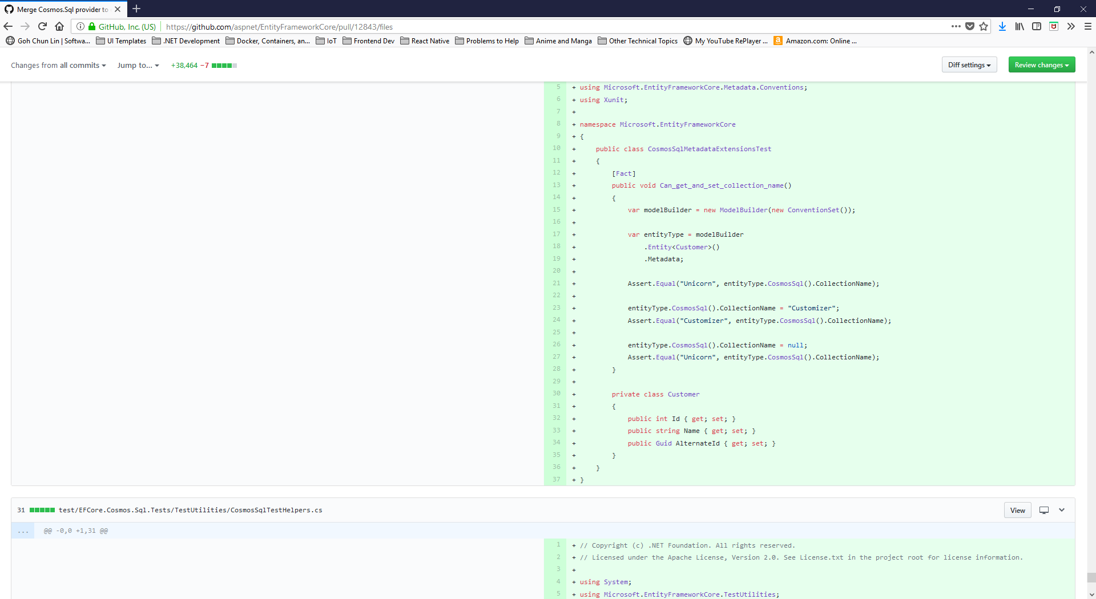
Problem of Unicorn
Notes:
https://github.com/aspnet/EntityFrameworkCore/pull/12843/files
https://csharp.christiannagel.com/2018/09/05/efcorecosmos/

Slide 22
Show Code!

Slide 23
Deployed to Azure

Slide 24
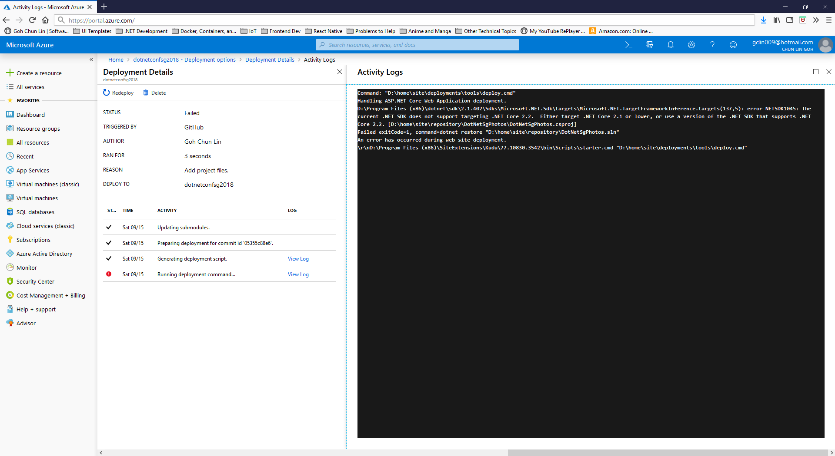
Oops, Not Supported
Notes:
https://github.com/aspnet/EntityFrameworkCore/pull/12843/files
https://csharp.christiannagel.com/2018/09/05/efcorecosmos/

Slide 25
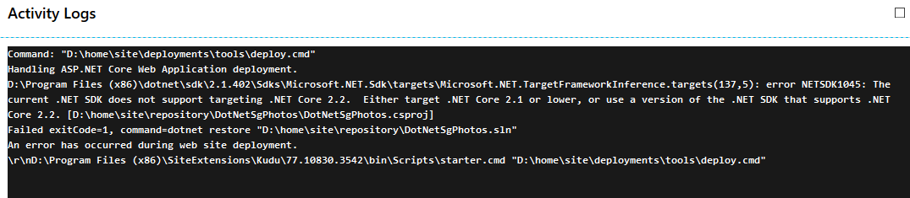
Oops, Not Supported
Notes:
https://github.com/aspnet/EntityFrameworkCore/pull/12843/files
https://csharp.christiannagel.com/2018/09/05/efcorecosmos/

Slide 26
Thank You Website: http://bit.ly/dotnetconfsg Repo: https://github.com/goh-chunlin/DotnetSgPhotos
Goh Chun Lin, Haulio CTO
@goh_chunlin | https://cuteprogramming.wordpress.com

Slide 27





Platinum Sponsors
Gold Sponsors
Other Sponsors

